Slide 1




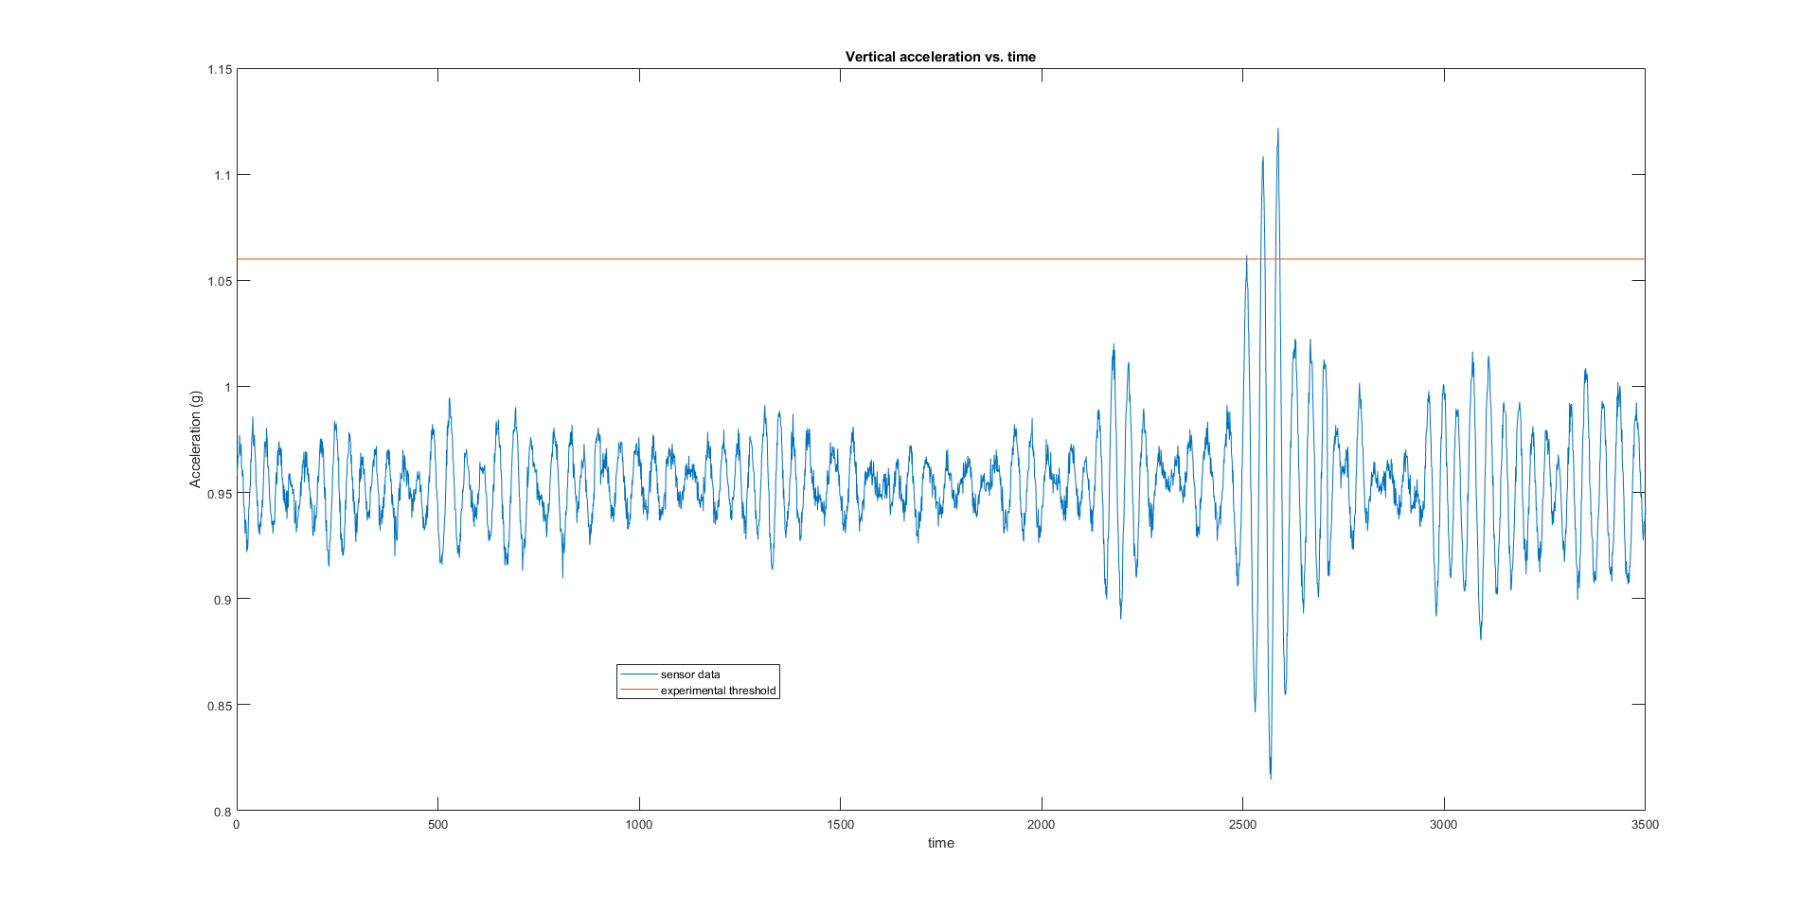
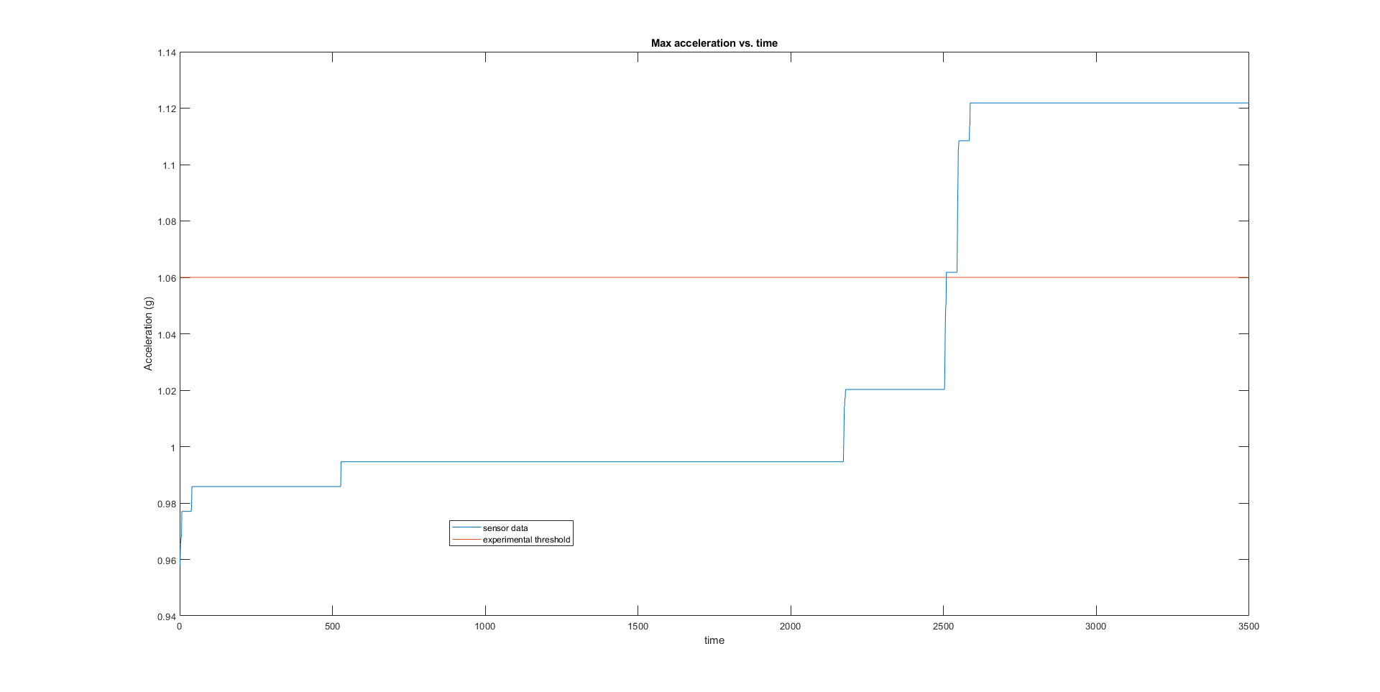
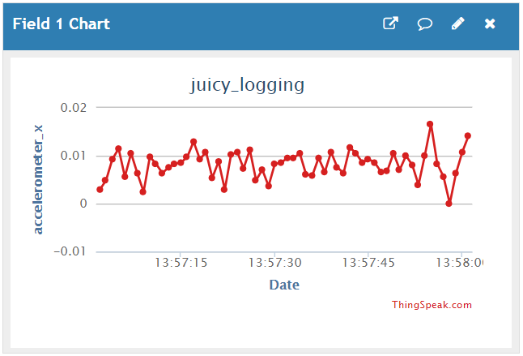
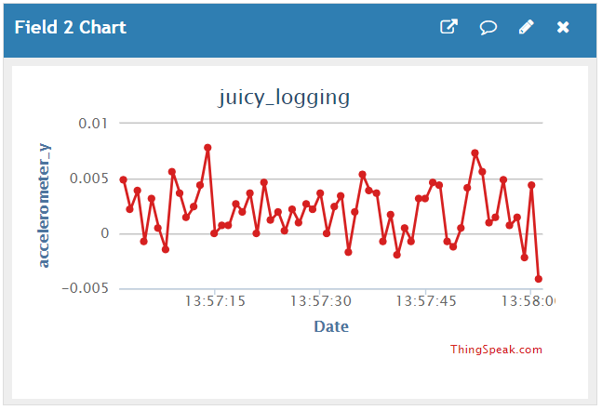
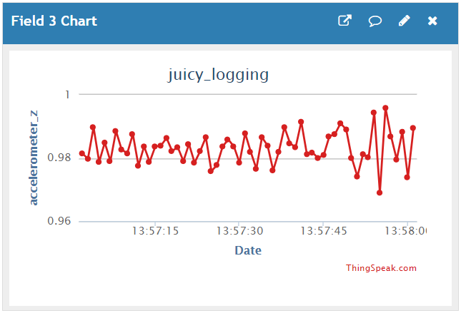
Software
Department of Electrical and Computer Engineering, Auburn University, Auburn, Alabama, USA
Program Design
Notifications
Initialize Data Comparison Value
Compare Sensor Data to Threshold
Update Comparison Value
Can send multiple kinds of notifications
Twilio
- calls and texts
- pricy but has desirable features
Pushetta
- app notifications
- free but is less developed
Send Alarm
Wait 15 s
Wait for Reset
Threshold Calibration
Data Acquisition
Wireless data logging with MathWorks’ ThingSpeak
- little interaction required and real time logging
- sped up testing phase
960 samples/second from accelerometer
- thresholds determined from this data
File storage on Raspberry Pi
- used to provide better timing information
- difficult to change during test
Notes:
Wireless data logging with MathWorks’ ThingSpeak
- little interaction required and real time logging
- sped up testing phase
960 samples/second from accelerometer
- thresholds determined from this data
File storage on Raspberry Pi
- used to provide better timing information
- difficult to change during test

